Slide 1
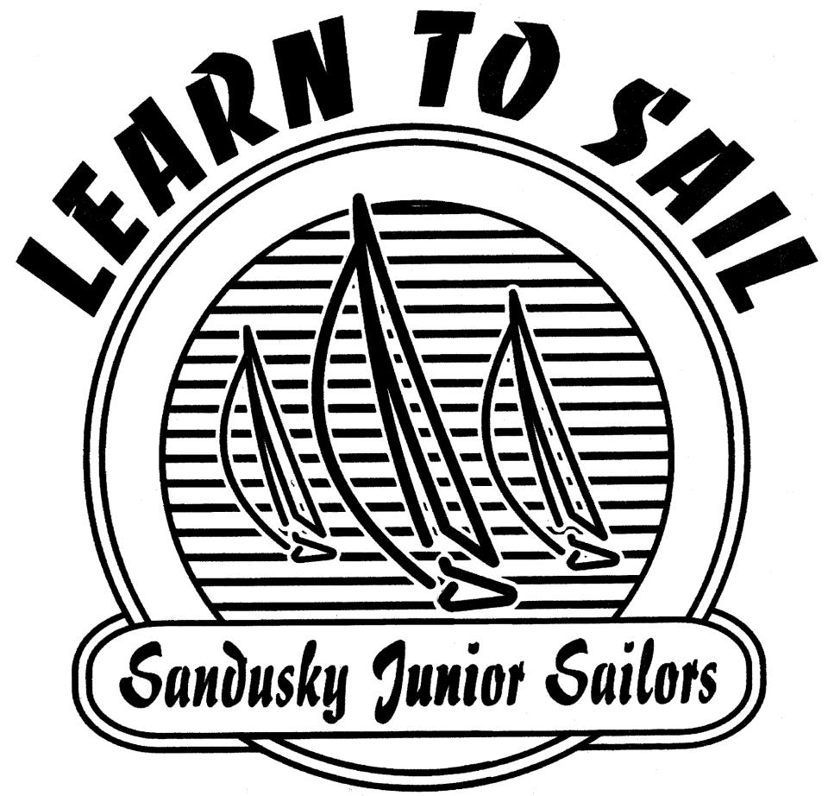
Located at: Sandusky Sailing Club
Directors: Suzanne Hartley & MacKenzie Kaufman

Slide 2
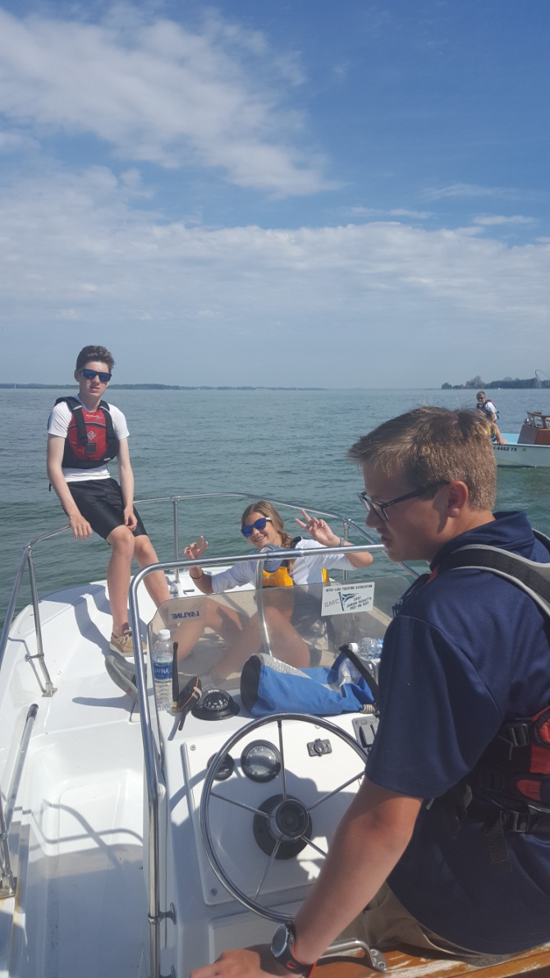
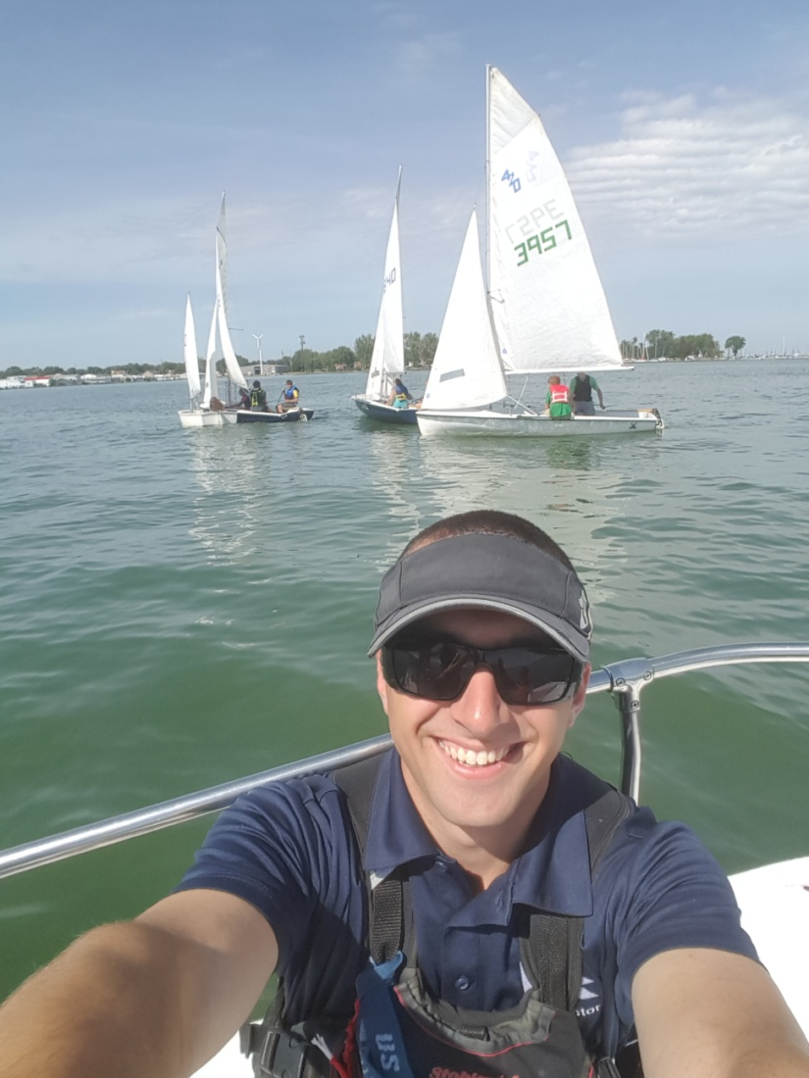
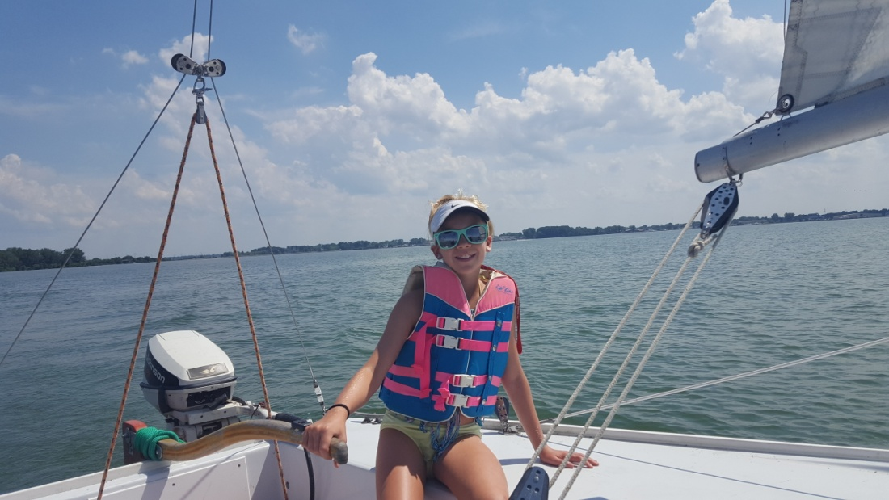
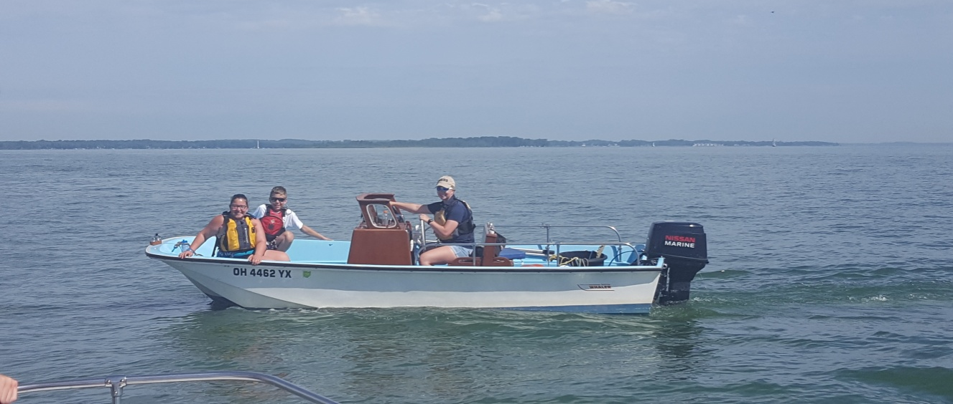
Sandusky Sailing Center
Youth Sailing Camps
Adult Sailing Classes
Adaptive Sailing
Community Sailing

Slide 3
Youth Sailing
Learn to Sail
Junior Race Team
Skill levels
Safety
Cool boat stuff
Skills
Rigging
Team attitude
Advanced Racing
Traveling Regattas
Different Fleets

Slide 4
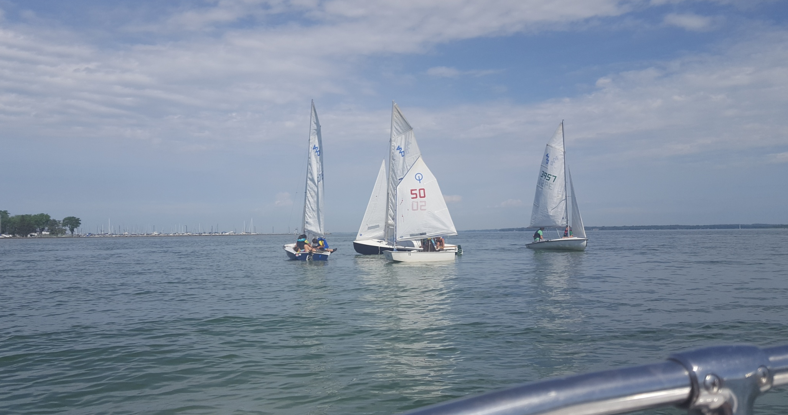
Learn to sail
Skill Evaluation levels
Basic
Intermediate
Advanced
Water safety
Sailing safety
Boat anatomy
Points of sail
Knots
Rigging
Team work

Slide 5
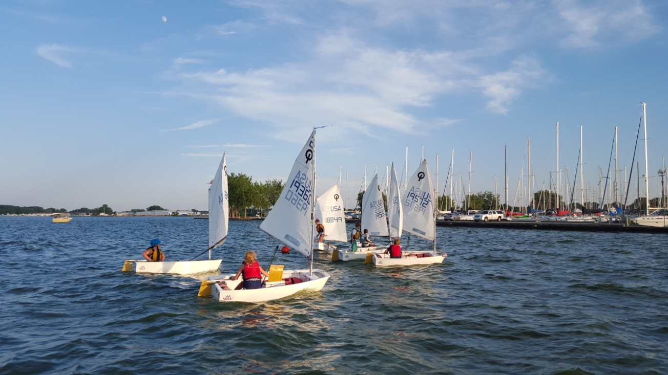

Slide 6
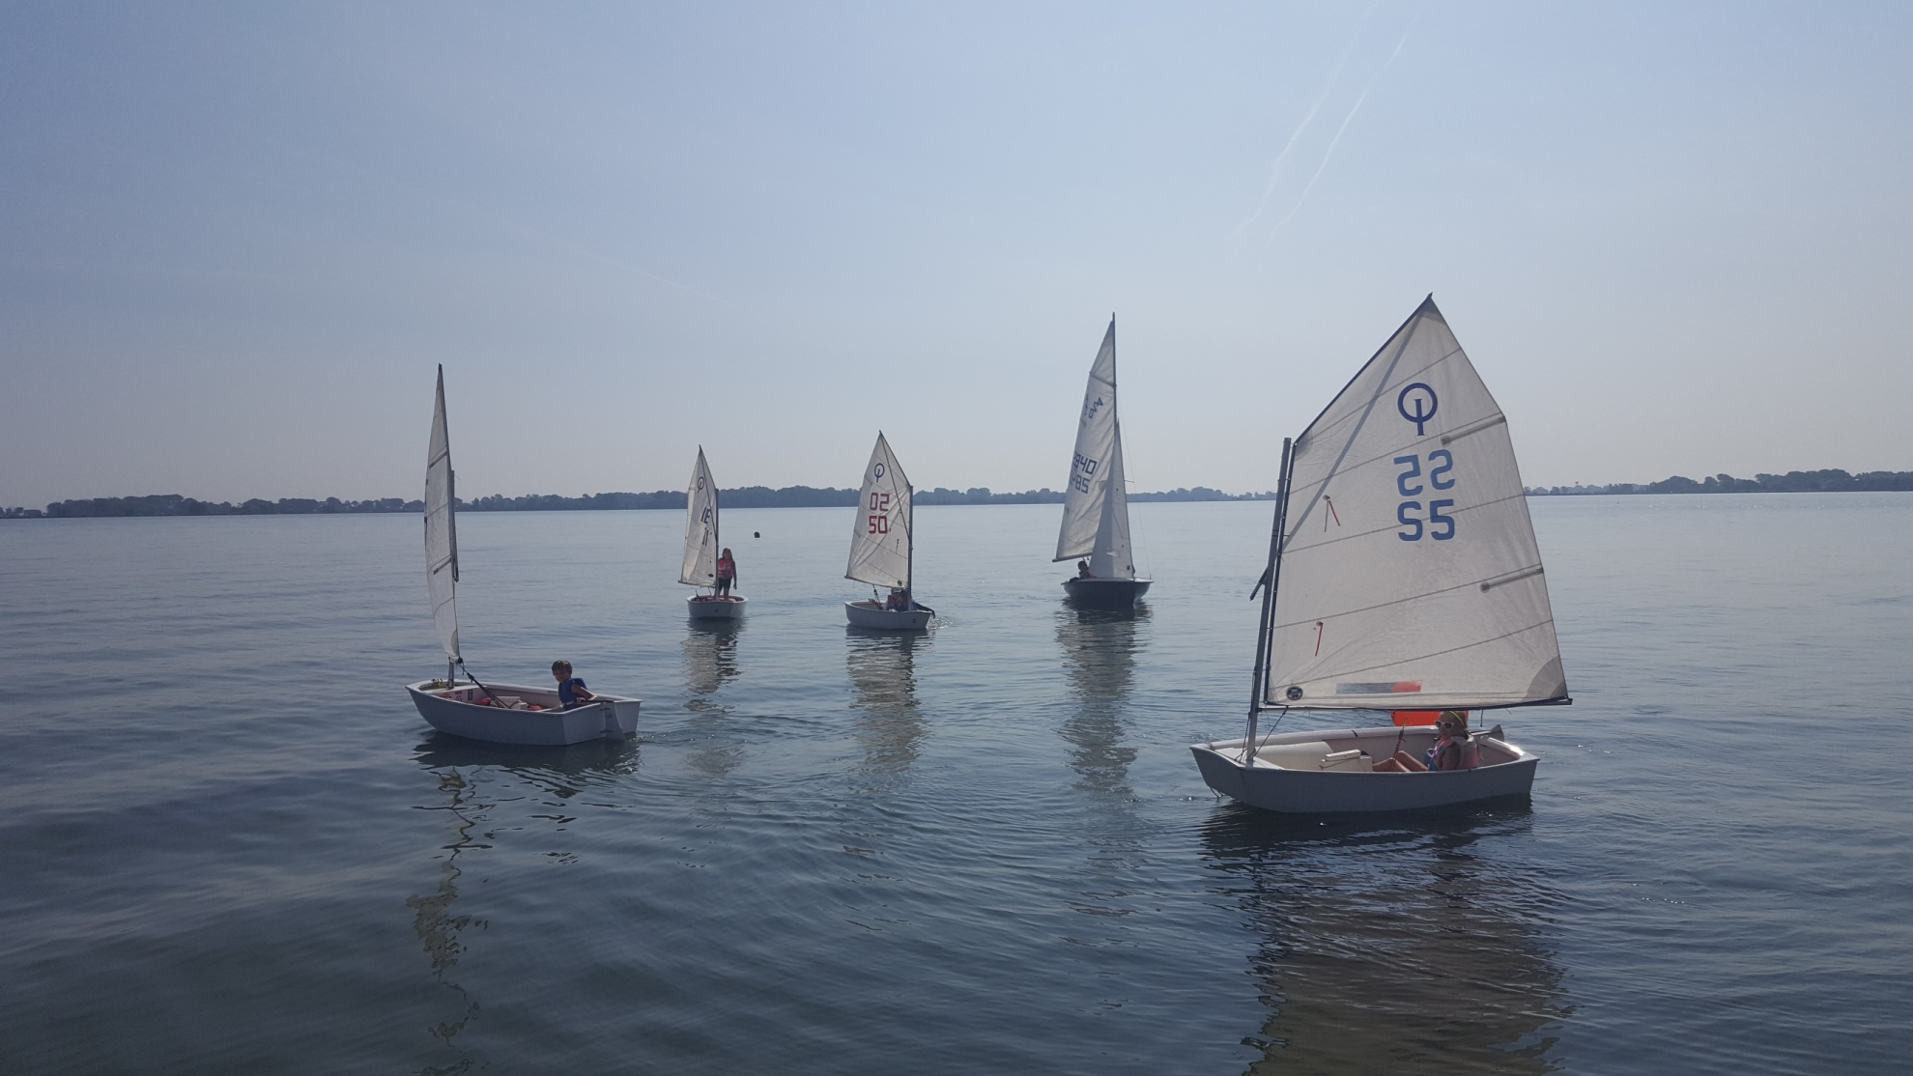

Slide 7
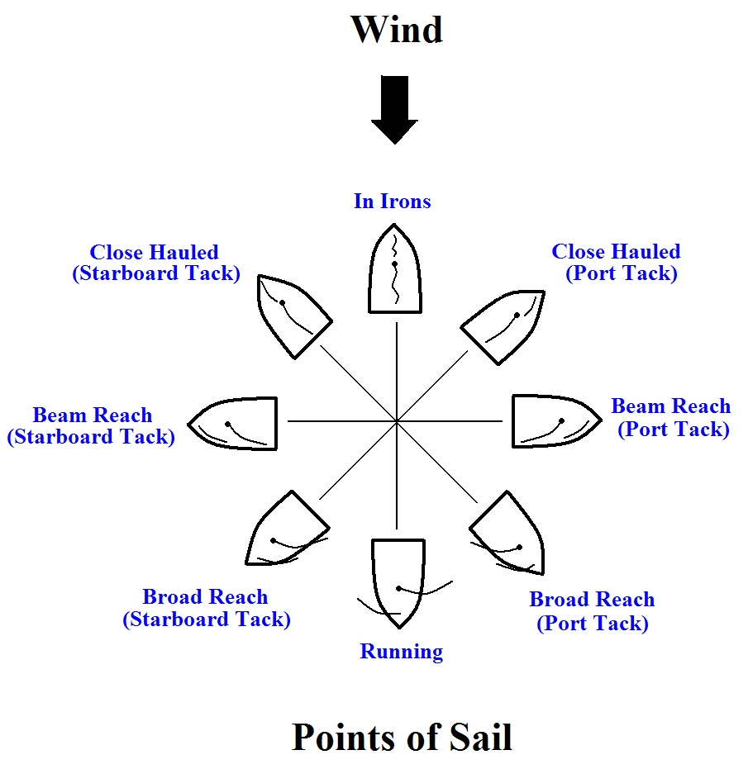
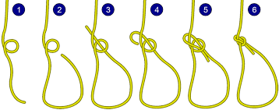
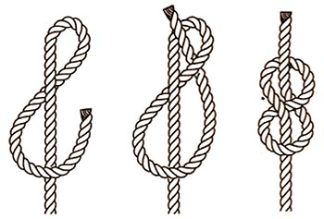
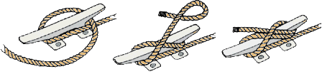

Slide 8
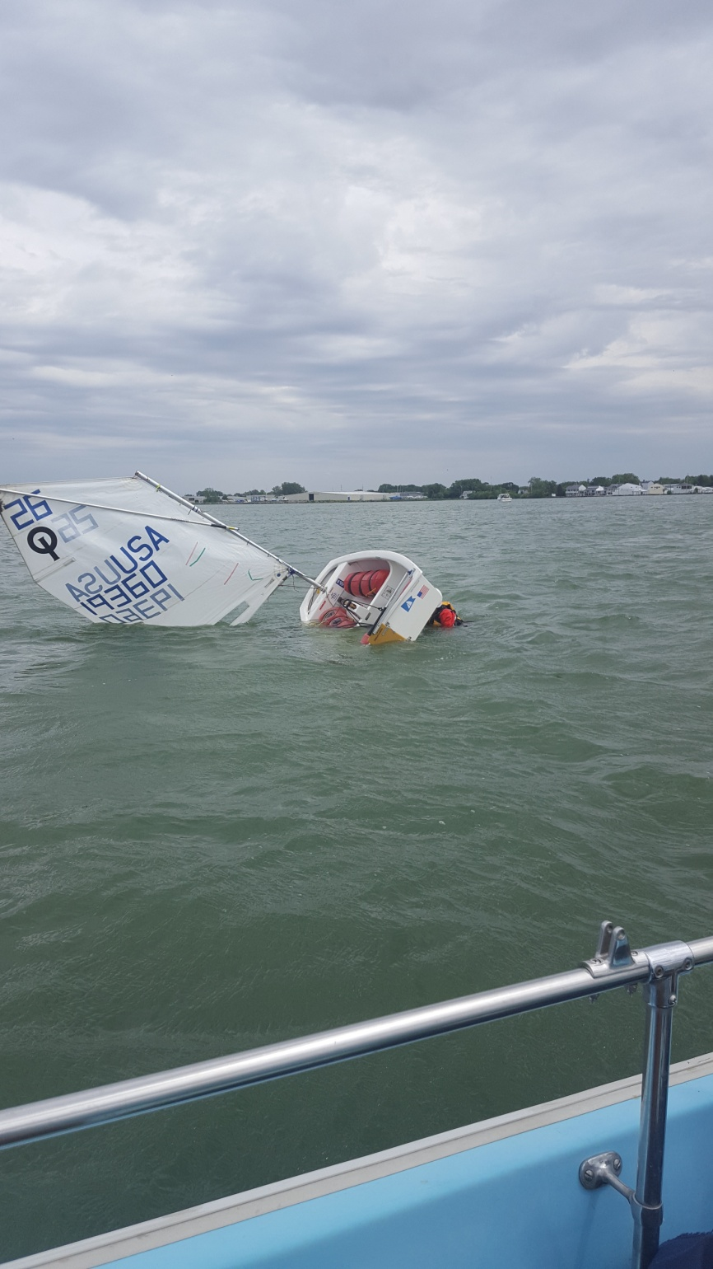
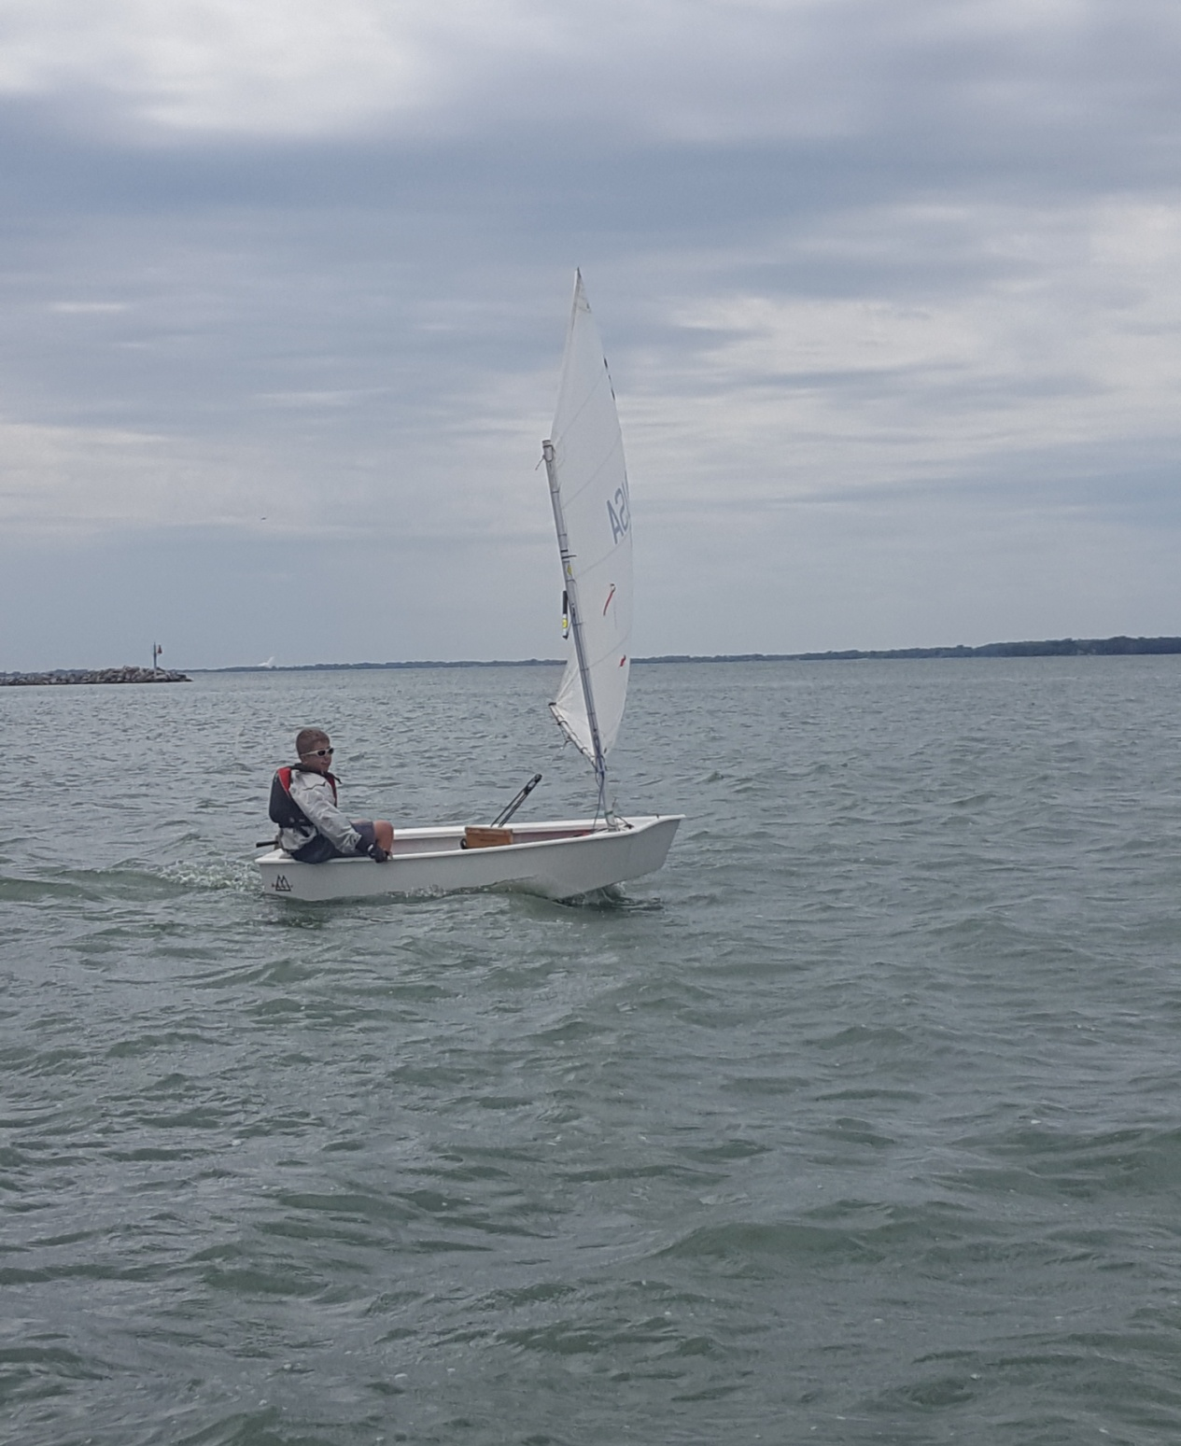
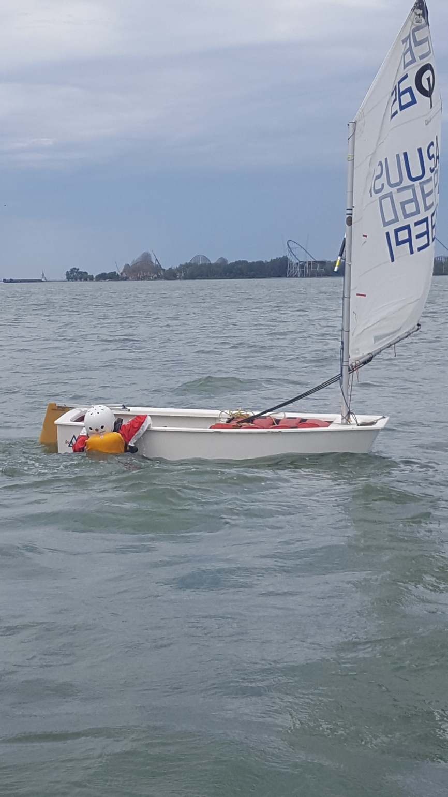
Capsizes

Slide 9
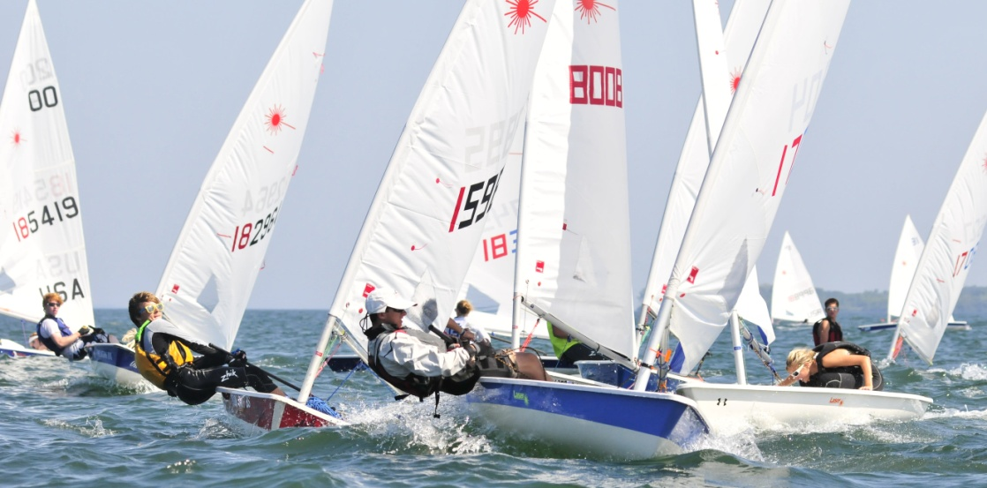
Junior Race Team
Racing
Tactics
Strategy
Advanced Boat Handling
Traveling Regattas
Indian to Pennsylvania
4 Different Fleets
Optimists
Lasers
C420
Thistle

Slide 10
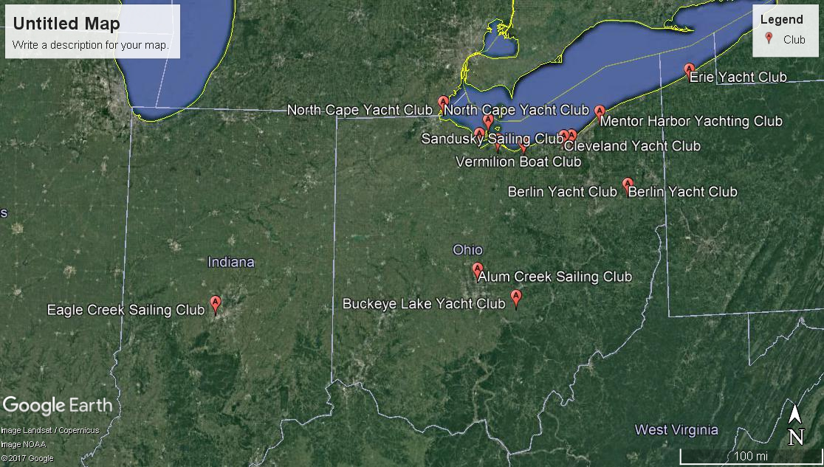
Just a few Clubs involved in I-LYA
North Cape Yacht Club
Port Clinton Yacht Club
Sandusky Sailing Club
Vermilion Boat Club
Cleveland Yacht Club
Edgewater Yacht Club
Mentor Harbor Yacht Club
Erie Yacht Club
Berlin Yacht Club
Alum Creek Sailing Club
Buckeye Lake Yacht Club
Eagle Creek Sailing Club
Hoover Sailing Club

Slide 11
Optimist Sailor
2015

Slide 12
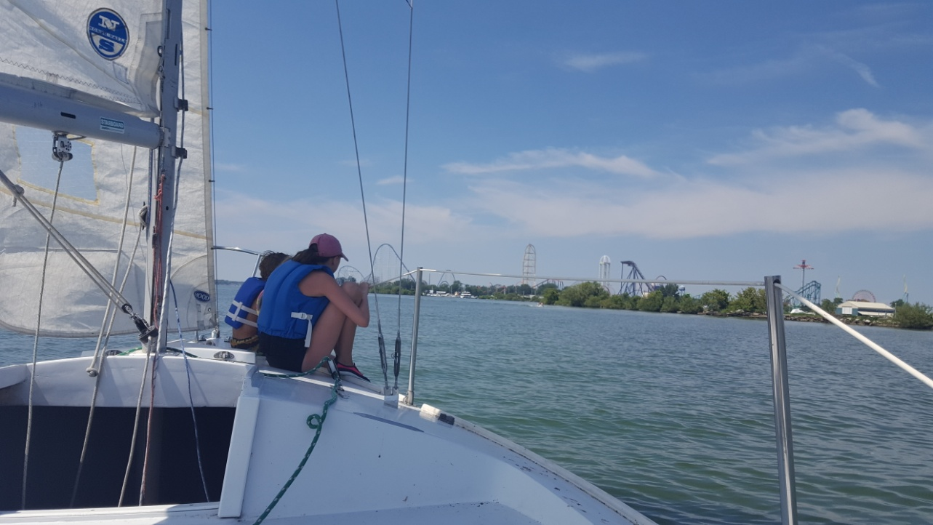
Adult Sailing Lessons
Low student to instructor ratio
Boats are provided by program
Modified J24
Charter boats available

Slide 13
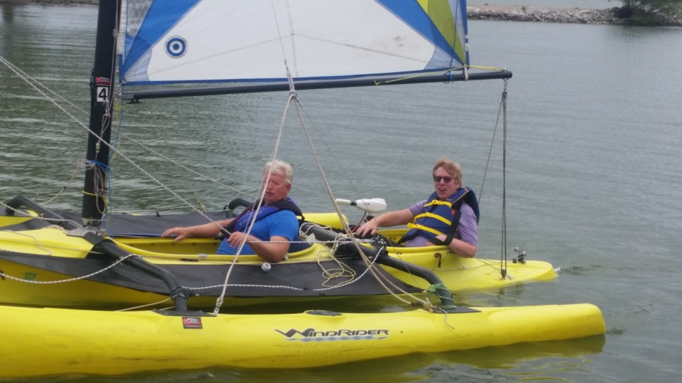
Adaptive Sailing
Boats designed for safety and mobility
Windrider 17
Corsair 28
Skilled Skipper on boat at all times
Training program to be a skipper
One on One instruction
Indestructible??

Slide 14
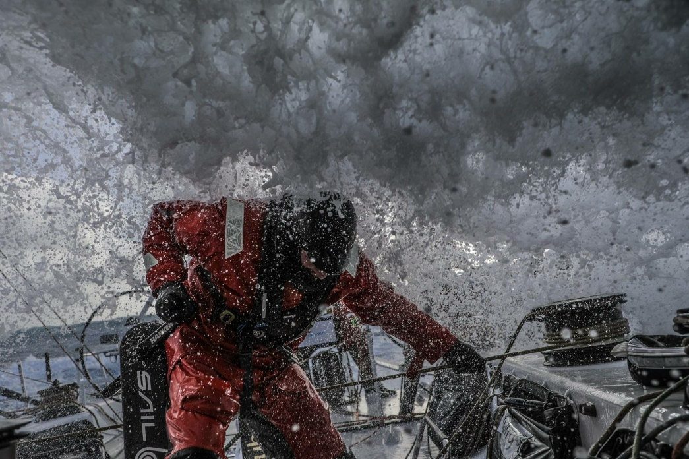
Any Questions?
Photo by Konrad Frost
Photo by Ugo Fonolla
Directors:
MacKenzie Kaufman EMT-B
US Sailing Level 3 Coach
Suzanne Hartley
Learn@sanduskysailingclub.com
Photo by Ainhoa Sanchez
Photos from the 2017-2018 Volvo Ocean Race

